Slide 1
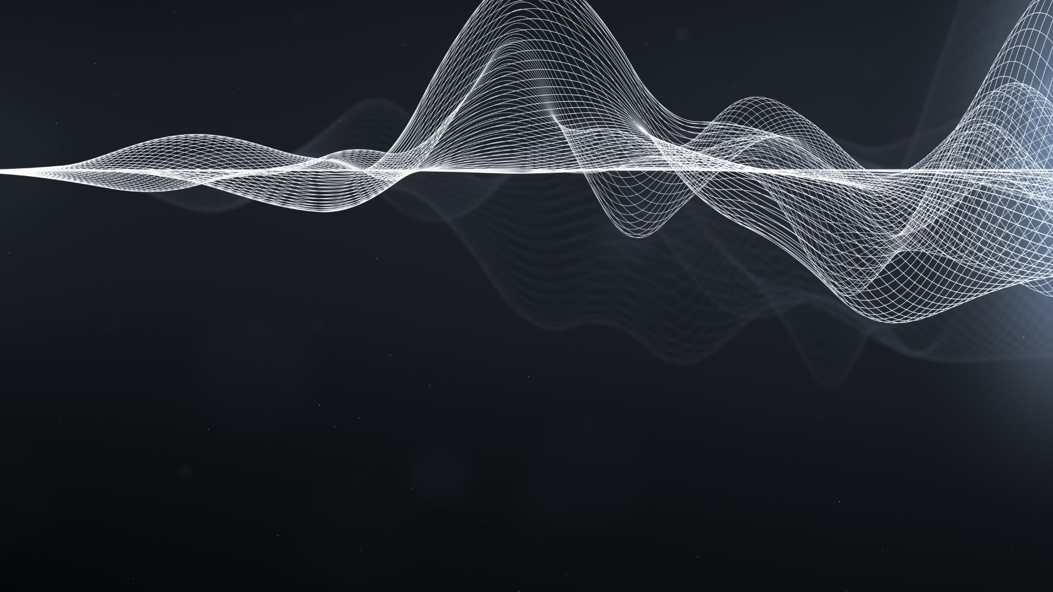
Quantum Sampling
Katedra Grafiki, Wizji Komputerowej i Systemów Cyfrowych
For Computation
Kamil Wereszczyński

Slide 2
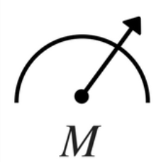
Deterministic QC
Interference
Superposition
Entanglement
Unitary operator
Hermitian operator
$$\left|ψ_{j}\right\rangle$$
$$\left|Ψ\right\rangle$$
initialization
evolution
measurement
Oracle
$$QFT$$
Phase est.
Ph. kick back
uncomputation

Slide 3
Quantum Sampling
Interference
Cosine series quantum Sampling
QCoSamp
Superposition
Entanglement
+
Meas.
basis
Quantum
Sampling
+
Cosine
series
-
+
-
+
-
$$\left|ψ_{j}\right\rangle$$
+
-
initialization
$$\left|{{X\left(NRS\right)}^{⊗N}c}_{1}…c_{2n}\right\rangle$$
measure
evolution
forging prob.
constants fixing
Oracle
$$QFT$$
agregate
Eigen States
Appearance hist.
FCoSamp
data encoding
Phase est.
ordering coords
Ph. kick back
uncomputation
phase extraction

Slide 4
Sketch of the evolution operator idea
$$e^{i\left(nx+s_{n}\right)}$$
+
$$1+e^{i(ax+s_{1})}$$
$$0 0 0$$
$$e^{i(nx+r_{n})}$$
-
$$1−e^{i\left(ax+s_{1}\right)}$$
$$0 0 1$$
1
0
+
$$0 1 0$$
$$1+e^{i\left(ax+r_{1}\right)}$$
$$n=a$$
-
$$1−e^{i\left(ax+r_{1}\right)}$$
$$0 1 1$$
Two components
phase extraction
+
$$1+e^{i\left(bx+s_{2}\right)}$$
$$1 0 0$$
-
$$1−e^{i\left(bx+s_{2}\right)}$$
$$1 0 1$$
+
$$1+e^{i\left(bx+r_{2}\right)}$$
$$1 1 0$$
$$n=b$$
-
$$1−e^{i\left(bx+r_{2}\right)}$$
$$1 1 1$$
$$\sum_{n=0}^{N}{λ_{n}\cos\left(nx\right)+γ_{n}\sin\left(nx\right)}$$
$$\sum_{n=1}^{N}{\frac{1+\cos\left(nx+r_{n}\right)}{L_{n}}+\frac{1+\cos\left(nx+s_{n}\right)}{L_{n}}}$$
$$\frac{1+cos⁡(ax+r_{1})}{2}+\frac{1+cos⁡(ax+s_{1})}{2}+ \\ \frac{1+cos⁡(bx+r_{1})}{2}+\frac{1+cos⁡(bx+s_{1})}{2}$$
$$λ_{n}= \cos\left(r_{n}\right)+\cos\left(s_{n}\right) \\ γ_{n}=−\sin\left(r_{n}\right)−\sin\left(s_{n}\right)$$

Slide 5
Meaning of qubits
$$\left|{{X\left(NRS\right)}^{⊗N}c}_{1}…c_{2n}\right\rangle$$
$$\left|XNRc\right\rangle$$
$$|x_{1}…x_{X} n_{1}…n_{N} r_{1}…r_{R} c⟩$$
Distributed phase encoding^{1,2,3}
$c=e^{−π}$;
for $k∈\left[1…Ω\right]$ do
$c∗=e^{i\frac{π}{2^{k}} δ_{1, ∗\left|ω_{k}\right\rangle }}$
$$e^{i\left(∗\left|N\right\rangle ∗\left|X\right\rangle +∗\left|R\right\rangle \right)}= \\ e^{i(nx+r)}$$
$$\prod_{k=0}^{R−1}{{cR}_{π⋅2^{−k}}}$$
$$\prod_{k=0}^{R−1}{e^{i\frac{π}{2^{k}}δ_{1,{∗|r}_{k}⟩}}}$$
$c=e^{−π}$;
for $k∈\left[1…Ω\right]$ do
if $ω_{k}=1$ then
$c∗=e^{i\frac{π}{2^{k}}}$;
$$×$$
$$cR_{π⋅2^{−k}}$$
$$e^{i∗\left|R\right\rangle }=e^{ir}$$
example
$$×$$
+
$$e^{iπ\sum_{k=0}^{R−1}{\frac{δ_{1,∗|r_{k}⟩}}{2^{k}}}}$$
$$\left|XNRc\right\rangle =?|0110 10 1011 0⟩$$
for $k∈\left[1…Ω\right]$ do
$c=c^{1+δ_{1,∗\left|ω_{k}\right\rangle }}$;
for $k∈\left[1…Ω\right]$ do
if $ω_{k}=1$ then
$c=c∗c$;
^
$${\left(cR_{φ}\right)}^{∘2}$$
$$cR_{2φ}$$
Values encoded by states: $\left|R\right\rangle \left|X\right\rangle \left|N\right\rangle$
$$×$$
$$e^{i\left(∗\left|10\right\rangle ∗\left|0110\right\rangle +∗|1011⟩\right)}$$
$$\prod_{j}^{N−1}{\prod_{k=0}^{X−1}{{ccR}_{π⋅2^{−k}}^{2^{j}}}}$$
$$\prod_{j}^{N−1}{\prod_{k=0}^{X−1}{e^{i\frac{π}{2^{k}}δ_{1,x_{k}}⋅2^{j}δ_{1,∗\left|n_{k}\right\rangle }}}}$$
$$×$$
^
+
$$e^{i\left(2⋅\left(−\frac{π}{4}\right)+\frac{3π}{8}\right)}$$
$$e^{i∗\left|N\right\rangle ∗\left|X\right\rangle }=e^{inx}$$
$$e^{iπ\sum_{k=0}^{X−1}{\frac{δ_{1,∗\left|x_{k}\right\rangle }}{2^{k}}}⋅\sum_{j=0}^{N−1}{2^{j}δ_{1,{∗|n}_{k}⟩ }}}$$
L. Ruiz-Perez and J. C. Garcia-Escartin, “Quantum arithmetic with the quantum Fourier transform,” Quantum Information Processing, vol. 16, June 2017.
T. G. Draper, “Addition on a Quantum Computer,” arXiv:quant-ph/0008033, Aug. 2000. arXiv: quant-ph/0008033.
S. Beauregard, G. Brassard, and J. M. Fernandez, “Quantum Arithmetic on Galois Fields,” arXiv:quant-ph/0301163, Jan. 2003. arXiv: quant-ph/0301163.

Slide 6
Isn’t it just fancy way of coding numbers?
Encodes the function $$μ\left(x\right)=\frac{1+\cos\left(2x+\frac{3π}{8}\right)}{2}$$
phase extraction
constants fixing
Let’s make constant the frequency $N$ and shift $R$ $$\left|XNRc\right\rangle =|x_{1}x_{2}x_{3}x_{4} 10 1011 0⟩$$
$x=0000$ => $e^{i\left(2⋅\left(−π\right)+\frac{3π}{8}\right)}$
$x=0001$ => $e^{i\left(2⋅\left(−\frac{7π}{8}\right)+\frac{3π}{8}\right)}$
…
$x=1111$ => $e^{i\left(2⋅\left(\frac{7π}{8}\right)+\frac{3π}{8}\right)}$
Quantum
$x=0000$ => $\frac{1+\cos\left(2⋅\left(−π\right)+\frac{3π}{8}\right)}{2}$
$x=0001$ =>$\frac{1+\cos\left(2⋅\left(−\frac{7π}{8}\right)+\frac{3π}{8}\right)}{2}$
…
$x=1111$ =>$\frac{1+\cos\left(2⋅\left(\frac{7π}{8}\right)+\frac{3π}{8}\right)}{2}$
$$x∈\left[−π, π\right)$$
$x$ resolution is $2^{X}$
Sampling
Let’s superpose $X$ leaving frequency and shift constant $$\left|XNRc\right\rangle =|0000 10 1011 0⟩$$
$000010 1011 0$=> $e^{i\left(2⋅\left(−π\right)+\frac{3π}{8}\right)}$
$000010 1011 1$=>1
$000110 1011 0$=>$e^{i\left(2⋅\left(−\frac{7π}{8}\right)+\frac{3π}{8}\right)}$
$000110 1011 1$=>1
…
$111110 1011 0$=> $e^{i\left(2⋅\left(\frac{7π}{8}\right)+\frac{3π}{8}\right)}$
$111110 1011 1$=> $1$
$000010 1011 0$=>$1+e^{i\left(2⋅\left(−π\right)+\frac{3π}{8}\right)}$
$000010 1011 1$=> $1−e^{i\left(2⋅\left(−π\right)+\frac{3π}{8}\right)}$
$000110 1011 0$=>$1+e^{i\left(2⋅\left(−\frac{7π}{8}\right)+\frac{3π}{8}\right)}$
$000110 1011 1$=> $1−e^{i\left(2⋅\left(−\frac{7π}{8}\right)+\frac{3π}{8}\right)}$
…
$111110 1011 0$=> $1+e^{i\left(2⋅\left(\frac{7π}{8}\right)+\frac{3π}{8}\right)}$
$111110 1011 1$=> $1−e^{i\left(2⋅\left(\frac{7π}{8}\right)+\frac{3π}{8}\right)}$
$$𝒪(const)$$
$$1$$
$$1$$
$$1$$
$$1$$
$$\int_{−π}^{π}{μ\left(x\right)dx}∼\frac{1}{2^{X}}⋅$$
$$\sum_{x∈\left[−π, π\right)}{μ(x)}$$
Quantum
Sampling

Slide 7
State comparison
data encoding
Now we have:
States $|X⟩$, $|Y⟩$.
if $\left|X\right\rangle =|Y⟩$ then $p\left|X\right\rangle =p|Y⟩$
so $μ\left(x_{k}\right)=y_{k}$
Constant reference (4 points): $$\left\{\left(x_{1},y_{1}\right),\left(x_{2},y_{2}\right),\left(x_{3},y_{3}\right),\left(x_{4},y_{4}\right)\right\}$$
Find $μ\left(x\right)$ s.t. $∀ k μ\left(x_{k}\right)=y_{k}$
The value of pdf for one or more qubits will give the answare
$|Y⟩$ => $\frac{1+\cos\left(y\right)}{2}$
$e^{iy_{k}}$=>$e^{icos^{−1}\left(2y_{k}−1\right)}:=e^{i{\hat{y}}_{k}}$
$$\left|X\right\rangle ={\left[e^{ix_{1}}, e^{ix_{2}}, e^{ix_{3}}, e^{ix_{4}}\right]}^{T}$$
$$\left|Y\right\rangle ={\left[e^{iy_{1}}, e^{iy_{2}}, e^{iy_{3}}, e^{iy_{4}}\right]}^{T}$$
$|Y⟩$ => $\frac{1+\cos\left(cos^{−1}\left(2y−1\right)\right)}{2}=\frac{1}{2}+\frac{2−y}{2}=y$
We want to check the state equality
For given $|XYNR…⟩$ check by QS if $\left|X\right\rangle =|Y⟩$
$$\left|Y\right\rangle ={\left[e^{i\cos^{−1}{{\hat{y}}_{1}}}, …,e^{i\cos^{−1}{{\hat{y}}_{4}}}\right]}^{T}$$
$|\hat{1}⟩$ - idle state
$$H^{⊗2}∘$$
$$\left|Ψc_{1}c_{2}\right\rangle$$
State similarity measure
$$\left|Φ_{1}\right\rangle =\frac{1}{\sqrt{2}}\left(\left|\hat{1}0\right\rangle +|X1⟩\right)$$
$$p|0⟩$$
state | basis
$$\left|X\right\rangle −|Y⟩$$ | $$|00⟩$$
$$2\left|\hat{1}\right\rangle +\left|X\right\rangle +|Y⟩$$ | $$|01⟩$$
$$\left|Y\right\rangle −|X⟩$$ | $$|10⟩$$
$$2\left|\hat{1}\right\rangle −\left|X\right\rangle −|Y⟩$$ | $$|11⟩$$
$$⊗$$
The same
$$0$$
$$\left|Φ_{2}\right\rangle =\frac{1}{\sqrt{2}}\left(\left|\hat{1}0\right\rangle −|Y1⟩\right)$$
1/2$\left[\left|\hat{1}0\hat{1}0\right\rangle −\left|\hat{1}0Y0\right\rangle +\left|X1\hat{1}0\right\rangle −\left|X1Y1\right\rangle \right]$
Most unsimilar
uncomputation
1/2$\left[\left|\hat{1}0\hat{1}0\right\rangle −\left|\hat{1}0Y0\right\rangle +\left|X1\hat{1}0\right\rangle −\left|\hat{1}1\hat{1}1\right\rangle \right]$
ordering coords
1/2$\left|\hat{1}\right\rangle \left[\left|\hat{1}00\right\rangle −\left|Y01\right\rangle +\left|X10\right\rangle −\left|\hat{1}11\right\rangle \right]$
½
$$\left|Ψc_{1}c_{2}\right\rangle$$
opposite

Slide 8
Superposing again
$$0$$
(cluster) entanglement
initial state: $$|XY\hat{1}NRc_{1}c_{2}⟩$$
$$\left|NR\right\rangle ⊗$$
$$H^{⊗2}∘$$
$$\left|Ψ(NR)c_{1}c_{2}\right\rangle$$
similarity measure
$$\left|X\right\rangle ={\left[e^{ix_{1}}, e^{ix_{2}}, e^{ix_{3}}, e^{ix_{4}}\right]}^{T}$$
$$\left|Y\right\rangle ={\left[e^{i\cos^{−1}{{\hat{y}}_{1}}}, …,e^{i\cos^{−1}{{\hat{y}}_{4}}}\right]}^{T}$$
$$\left|NR\right\rangle ⊗$$
$$H^{⊗2}∘$$
$$\left|Ψc_{1}c_{2}\right\rangle$$
$$p|0⟩$$
$\left|Ψ\right\rangle$ depends on $|NR⟩$, $p\left|0\right\rangle$ - as well
Similarity of $y$ and $μ(x)$ param. wth. $n,r$
depends on
You can choose the best probability
because of
½
It is ugly and the Measurement basis grows exponentially
Let’s superpose $\left|R\right\rangle$:
Probabilities:
$\left|Ψ\left(N,−\frac{8π}{8}\right)c_{1}c_{2}\right\rangle$
$\left|Ψ\left(N,−\frac{7π}{8}\right)c_{1}c_{2}\right\rangle$
…
$\left|Ψ\left(N,+\frac{7π}{8}\right)c_{1}c_{2}\right\rangle$
$\left[e^{i\left(nx−\frac{8π}{8}\right)}−e^{icos^{−1}\hat{y}}\right]\left|00\right\rangle$+ $\left[e^{icos^{−1}\hat{y}}−e^{i\left(nx−\frac{8π}{8}\right)}\right]\left|10\right\rangle +…$
$$p\left|R→−1.000π\right\rangle |0⟩$$
$\left[e^{i\left(nx−\frac{7π}{8}\right)}−e^{icos^{−1}\hat{y}}\right]\left|00\right\rangle$+ $\left[e^{icos^{−1}\hat{y}}−e^{i\left(nx−\frac{7π}{8}\right)}\right]\left|10\right\rangle +…$
$$p\left|R→−0.875π\right\rangle |0⟩$$
$\left[e^{i\left(nx+\frac{7π}{8}\right)}−e^{icos^{−1}\hat{y}}\right]\left|00\right\rangle$+ $\left[e^{icos^{−1}\hat{y}}−e^{i\left(nx+\frac{7π}{8}\right)}\right]\left|10\right\rangle +…$
$$p\left|R→+0.875π\right\rangle |0⟩$$

Slide 9
Forging probability
„good” state
We want to achieve it
Oracle as function
$$χ_{Ω}\left(ξ\right)=\left\{\begin{aligned}0 ∀ω∈Ω:ξ≠Ω \\ 0 ∃ω∈Ω:ξ∉Ω\end{aligned}\right.$$
Oracle as operator
$$𝒰_{ω}\left|x\right\rangle =\left\{\begin{aligned}−\left|x\right\rangle χ_{ω}\left(x\right)=1 \\ +\left|x\right\rangle χ_{ω}\left(x\right)=0\end{aligned}\right.$$
Initial state
$|φ⟩$- uniform superposition
$$𝒰_{φ}=2|φ⟩⟨φ|−1$$
Amplitude amplification:
$𝒰_{φ}𝒰_{ω}𝒰_{φ}𝒰_{ω}$…
We define good state:
$𝒰_{ω}=1−2|ω⟩⟨ω|$
$$H^{⊗2}∘$$
$$\left|Ψ(NR)c_{1}c_{2}\right\rangle$$
$$|N⟩\left|R→−1.000π\right\rangle$$
It is like a „forging die”
$$|N⟩\left|R→−0.875π\right\rangle$$
$$\left|X(R)\right\rangle −|Y(R)⟩$$ | $$|00⟩$$
$$2\left|\hat{1}\right\rangle +\left|X(R)\right\rangle +|Y(R)⟩$$ | $$|01⟩$$
$$\left|Y(R)\right\rangle −|X(R)⟩$$ | $$|10⟩$$
$$2\left|\hat{1}\right\rangle −\left|X\left(R\right)\right\rangle −|Y(R)⟩$$ | $$|11⟩$$
$$0$$ | $$|00⟩$$
$$2\left(\left|\hat{1}\right\rangle +\left|X\left(R\right)\right\rangle \right)$$ | $$|01⟩$$
$$0$$ | $$|10⟩$$
$$2\left(\left|\hat{1}\right\rangle −\left|X\left(R\right)\right\rangle \right)$$ | $$|11⟩$$
„Amp Amp” is like a hammer
$$|N⟩\left|R→−0.750π\right\rangle$$
$$⊗$$
$$|N⟩\left|……………….\right\rangle$$
State $\left|φ\right\rangle$ is shaped to be best fit of the $|ω⟩$ (die).
$$|N⟩\left|R→+0.675π\right\rangle$$
$$|N⟩\left|R→+0.750π\right\rangle$$
$$|N⟩\left|R→+0.875π\right\rangle$$
$$|φ⟩$$
$$|ω⟩$$

Slide 10
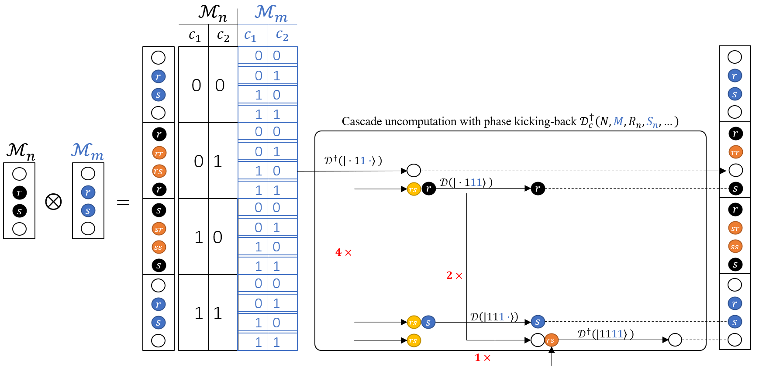
The architecture of QCoSamp
$$\left|XNRc\right\rangle$$
??
$$\left|{{X\left(NRS\right)}^{⊗N}c}_{1}…c_{2n}\right\rangle$$
$$\left|c\right\rangle ={\left[1, e^{i(nx+r)}\right]}^{T}$$
Unwanted interference
First component
$$\left|XNR_{1}c_{1}\right\rangle$$
$$\left[\begin{matrix}\begin{matrix}1 \\ e^{i(nx+s_{1})}\end{matrix} \\ \begin{matrix}e^{i(nx+r_{1})} \\ e^{i(nx+s_{1})}e^{i(nx+r_{1})}\end{matrix}\end{matrix}\right]$$
$$\left[\begin{matrix}\begin{matrix}1 \\ e^{i(nx+s_{1})}\end{matrix} \\ \begin{matrix}e^{i(nx+r_{1})} \\ 1\end{matrix}\end{matrix}\right]$$
$$⊗$$
uncomputation
$$\left|XNS_{1}c_{2}\right\rangle$$
$$⊗$$
$$\left|XNR_{2}c_{3}\right\rangle$$
Second component
$$\left[\begin{matrix}\begin{matrix}1 \\ e^{i(nx+s_{2})}\end{matrix} \\ \begin{matrix}e^{i(nx+r_{2})} \\ e^{i(nx+s_{2})}e^{i(nx+r_{2})}\end{matrix}\end{matrix}\right]$$
$$\left[\begin{matrix}\begin{matrix}1 \\ e^{i(nx+s_{2})}\end{matrix} \\ \begin{matrix}e^{i(nx+r_{2})} \\ 1\end{matrix}\end{matrix}\right]$$
$$⊗$$
uncomputation
$$\left|XNS_{2}c_{4}\right\rangle$$
$\left|XNRc\right\rangle$=> $\left|XNR_{1}S_{1}c_{1}c_{2}\right\rangle$=> $\left|XNR_{1}S_{1}c_{1}c_{2}NR_{2}S_{2}c_{3}c_{4}\right\rangle$=> $\left|X{\left(NRS\right)}^{⊗2}c_{1}…c_{2⋅2}\right\rangle$

Slide 11
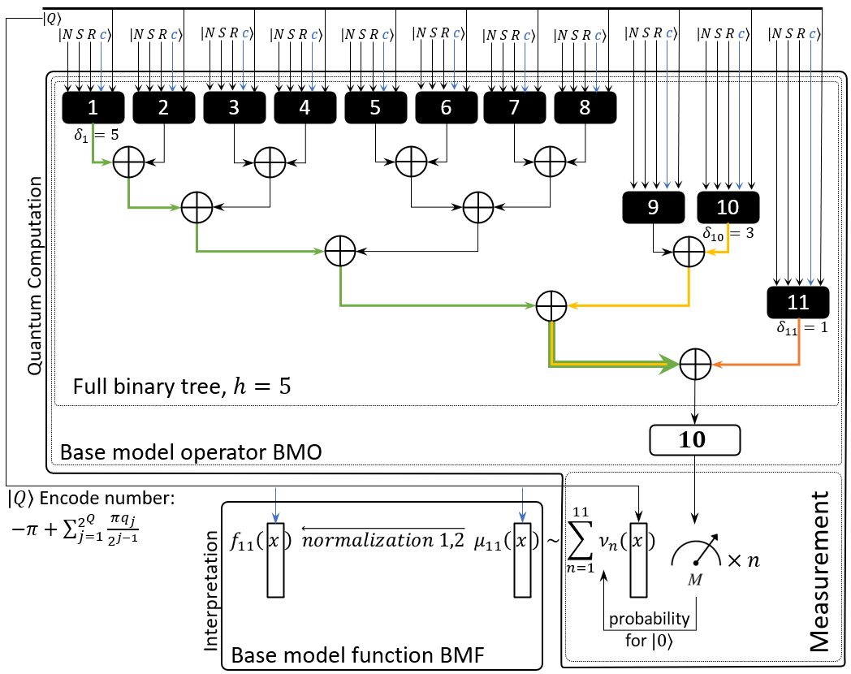
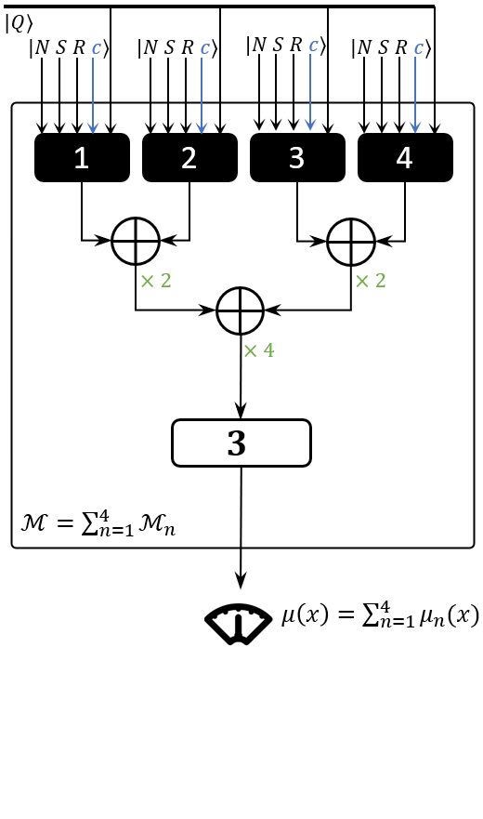
To balance or not to balance?

