Slide 1
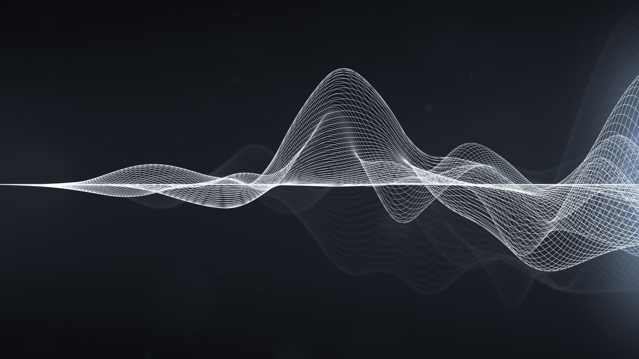


LOOK
Katedra Grafiki, Wizji Komputerowej i Systemów Cyfrowych
The laboratory of quantum computation based on optical phenomena in Gliwice (SUT)
Kamil Wereszczyński

Slide 2



Deterministic QC
Unitary operator
Hermitian operator
$$\left|ψ_{j}\right\rangle$$
$$\left|Ψ\right\rangle$$
initialization
evolution
measurement

Slide 3



Quantum Sampling
+
Meas.
basis
-
+
-
+
-
$$\left|ψ_{j}\right\rangle$$
+
-
initialization
$$\left|{X^{⊗N}c}_{1}…c_{n}\right\rangle$$
measure
evolution
Eigen States
Appearance histogram
agregate

Slide 4
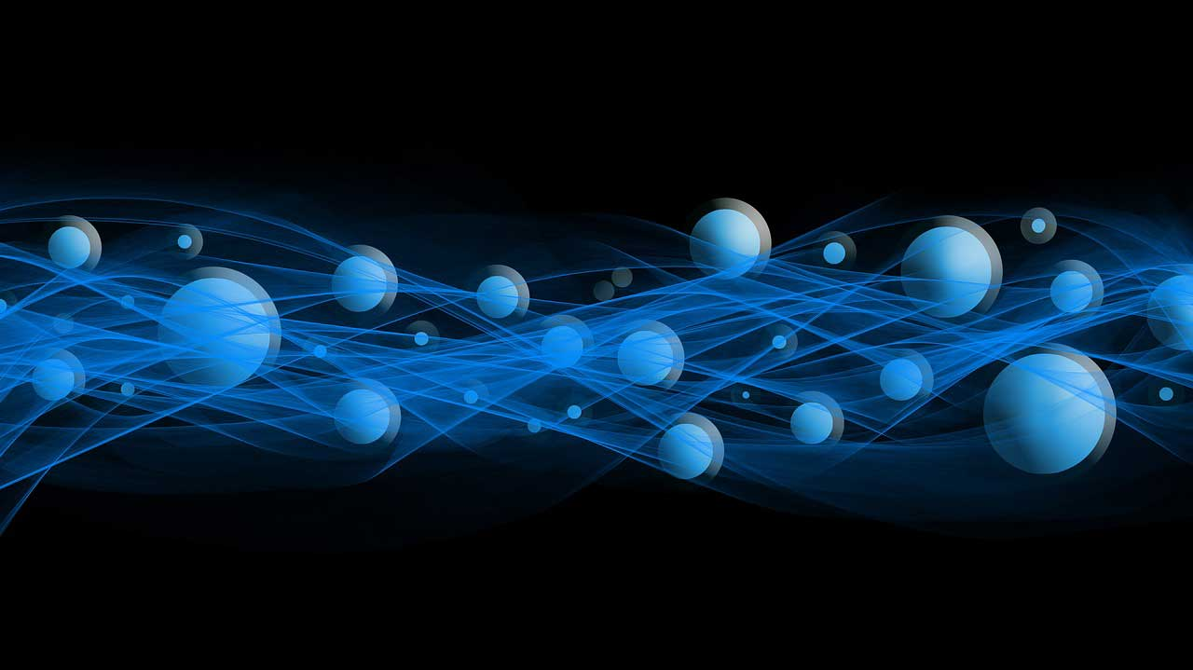




Photons as qudits
QUBIT
LIGHT
Polarization?
Position?
Many particles
What is $\left|0\right\rangle$, $|1⟩$ ?
$$|1⟩$$
$$|0⟩$$
$$|ψ⟩$$
We need a tool!
Fock space
„Particle Counter”

Slide 5











Fock space
How many particles can we have?
No particles
Just one
Two identical
…
N identical
…
$$ℂ$$
$$⊕$$
$$ℋ$$
$$⊕$$
$$ℋ⊗ℋ$$
$$⊕$$
$$⊕$$
$$⊕$$
…
…
$$H^{⊗N}$$
$$\left|ψ\right\rangle =| ψ_{1}, ψ_{2},…, ψ_{N}, …⟩$$
Product state
$$Ψ=⊕_{n=0}^{∞}S_{n}H^{⊗n}$$

Slide 6




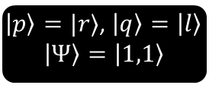



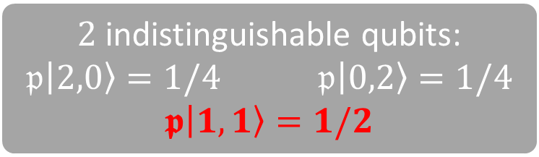

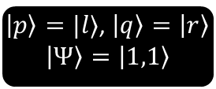

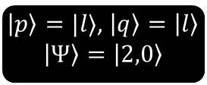
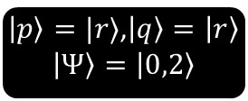
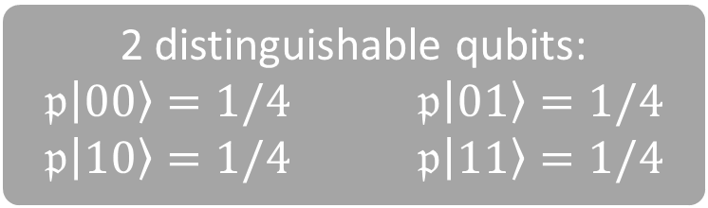









And the problem is….
Particles
(bozons)
$\left|p\right\rangle =|l⟩$, $\left|q\right\rangle =\left|l\right\rangle$
$$\left|Ψ\right\rangle =\left|2,0\right\rangle$$
$\left|p\right\rangle =|r⟩$,$\left|q\right\rangle =\left|r\right\rangle$
$$\left|Ψ\right\rangle =\left|0,2\right\rangle$$
$$p$$
$$p$$
states
$$q$$
$$q$$
$$|l⟩$$
$$|r⟩$$
$$|l⟩$$
$$|r⟩$$
$$|l⟩$$
$$|r⟩$$
2 distinguishable qubits:
$𝔭\left|00\right\rangle =1/4$ $𝔭\left|01\right\rangle =1/4$
$𝔭\left|10\right\rangle =1/4$ $𝔭\left|11\right\rangle =1/4$
$\left|p\right\rangle =|l⟩$, $\left|q\right\rangle =\left|r\right\rangle$
$$\left|Ψ\right\rangle =\left|1,1\right\rangle$$
Same Fock state
$\left|p\right\rangle =|r⟩$, $\left|q\right\rangle =\left|l\right\rangle$
$$\left|Ψ\right\rangle =\left|1,1\right\rangle$$
$2$ indistinguishable qubits:
$𝔭\left|2,0\right\rangle =1/4$ $𝔭\left|0,2\right\rangle =1/4$
$𝖕\left|1,1\right\rangle =1/2$
To distinguish ??
Not to distinguish ??
$$p$$
$$p$$
$$q$$
$$q$$
$$|l⟩$$
$$|r⟩$$
$$|l⟩$$
$$|r⟩$$

Slide 7


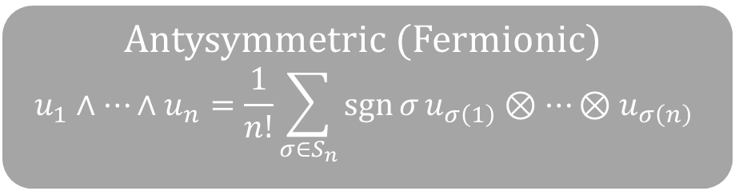
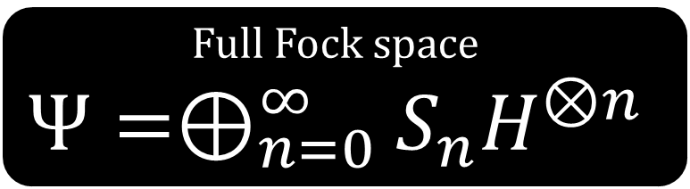

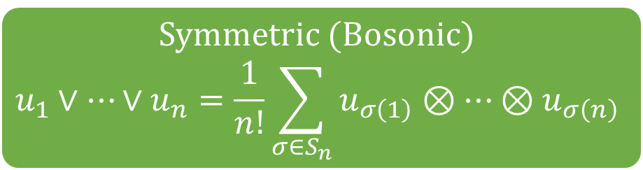


To be formally correct …
Full Fock space
$$Ψ=⊕_{n=0}^{∞}S_{n}H^{⊗n}$$
$$\left|0\right\rangle ∨\left|0\right\rangle =\frac{\left|00\right\rangle +\left|00\right\rangle }{2}=\left|00\right\rangle \\ \left|0\right\rangle ∨\left|1\right\rangle =\frac{\left|01\right\rangle +\left|10\right\rangle }{2} \\ \left|1\right\rangle ∨\left|0\right\rangle =\frac{\left|10\right\rangle +\left|01\right\rangle }{2} \\ \left|1\right\rangle ∨\left|1\right\rangle =\frac{\left|11\right\rangle +\left|11\right\rangle }{2}=|11⟩$$
$$\left|0\right\rangle ∧\left|0\right\rangle =\frac{\left|00\right\rangle −\left|00\right\rangle }{2}=0 \\ \left|0\right\rangle ∧\left|1\right\rangle =\frac{\left|01\right\rangle −\left|10\right\rangle }{2} \\ \left|1\right\rangle ∧\left|0\right\rangle =\frac{\left|10\right\rangle −\left|01\right\rangle }{2} \\ \left|1\right\rangle ∧\left|1\right\rangle =\frac{\left|11\right\rangle −\left|11\right\rangle }{2}=0$$
Symmetric (Bosonic)
$$Ψ=⊕_{n=0}^{∞}S_{n}H^{∨n}$$
Antysymmetric (Fermionic)
$$Ψ=⊕_{n=0}^{∞}S_{n}H^{∧n}$$
$$\left|01\right\rangle +\left|10\right\rangle$$
Equal !!
Different
Symmetric (Bosonic)
$$u_{1}∨…∨u_{n}=\frac{1}{n!}\sum_{σ∈S_{n}}^{ }{u_{σ\left(1\right)}⊗…⊗u_{σ\left(n\right)}}$$
Antysymmetric (Fermionic)
$$u_{1}∧…∧u_{n}=\frac{1}{n!}\sum_{σ∈S_{n}}^{ }{\operatorname{sgn}{σ}u_{σ\left(1\right)}⊗…⊗u_{σ\left(n\right)}}$$
Pauli exclusion

Slide 8

















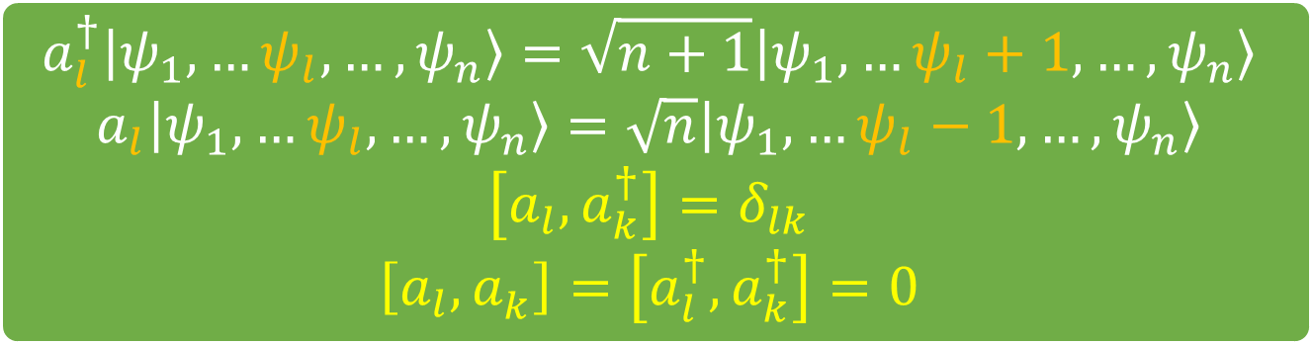













Producing states
$$a_{l}^{†}\left|Ψ\right\rangle$$
$$\left|Ψ\right\rangle =\left|2,0\right\rangle$$
$${a_{l}^{ }}^{ }\left|Ψ\right\rangle$$
$$a_{l}^{†}\left|Ψ\right\rangle$$
$$\left|Ψ\right\rangle =\left|1,0\right\rangle$$
$${a_{l}^{ }}^{ }\left|Ψ\right\rangle$$
$$a_{l}^{†}\left|Ψ\right\rangle$$
$$|l⟩$$
$$|r⟩$$
$${a_{r}^{ }}^{ }\left|Ψ\right\rangle$$
$$\left|Ψ\right\rangle =\left|0,0\right\rangle$$
$$a_{l}^{†}\left|ψ_{1},…ψ_{l},…, ψ_{n}\right\rangle =\sqrt{n+1}\left|ψ_{1},…ψ_{l}+1,…, ψ_{n}\right\rangle$$
$$a_{l}\left|ψ_{1},…ψ_{l},…, ψ_{n}\right\rangle =\sqrt{n}\left|ψ_{1},…ψ_{l}−1,…, ψ_{n}\right\rangle$$
$$\left[a_{l}, a_{k}^{†}\right]=δ_{lk} \\ \left[a_{l}, a_{k}^{ }\right]=\left[a_{l}^{†}, a_{k}^{†}\right]=0$$
$$|l⟩$$
$$|r⟩$$
$$\left|Ψ\right\rangle =\left|1,1\right\rangle$$
$$|l⟩$$
$$|r⟩$$
$$|l⟩$$
$$|r⟩$$
$$a_{r}^{ }\left|Ψ\right\rangle$$
$$a_{l}^{†}\left|Ψ\right\rangle$$
$${a_{r}^{ }}^{ }\left|Ψ\right\rangle$$
$$\left|Ψ\right\rangle =\left|0,1\right\rangle$$
$${a_{l}^{ }}^{ }\left|Ψ\right\rangle$$
$$\left|Ψ\right\rangle =\left|0,2\right\rangle$$
$$a_{l}^{†}\left|Ψ\right\rangle$$
$$|l⟩$$
$$|r⟩$$
$${a_{r}^{ }}^{ }\left|Ψ\right\rangle$$
$$|l⟩$$
$$|r⟩$$

Slide 9
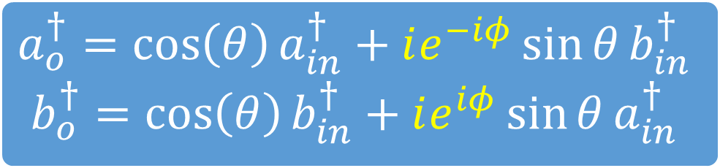


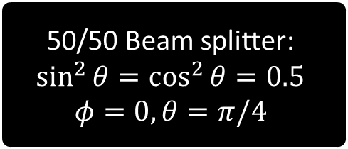
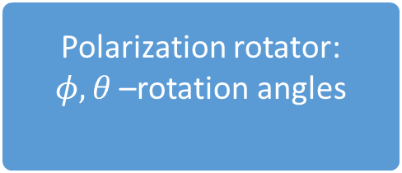
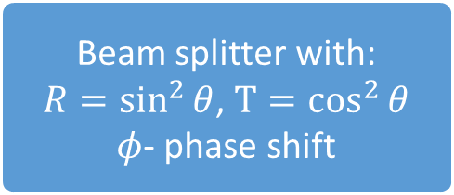
Linear optics elements
$$a_{o}^{†}=e^{iφ}a_{in}^{†}$$
Phase shifter by phase $φ$
$$a_{o}^{†}=\cos\left(θ\right)a_{in}^{†}+ie^{−iφ}\sin{θ}b_{in}^{†}$$
$$b_{o}^{†}=\cos\left(θ\right)b_{in}^{†}+ie^{iφ}\sin{θ}a_{in}^{†}$$
Beam splitter with:
$R=\sin^{2}{θ}$, $T=\cos^{2}{θ}$
$φ$- phase shift
Polarization rotator:
$φ, θ$ –rotation angles
50/50 Beam splitter:
$$\sin^{2}{θ}=\cos^{2}{θ}=0.5$$
$$φ=0, θ=π/4$$
$$a_{o}^{†}=1/\sqrt{2}\left[a_{in}^{†}+ib_{in}^{†}\right]$$
$$b_{o}^{†}=1/\sqrt{2}\left[b_{in}^{†}+ia_{in}^{†}\right]$$

Slide 10











KLM – photon bunching
BS 50/50
detector
½
$$c$$
$${\left|1,1\right\rangle }_{ab}$$
$$d$$
detector
½
$${\left|1,1\right\rangle }_{ab}$$
½ $\left({c^{†}}^{2}−{d^{†}}^{2}\right){\left|0\right\rangle }_{cd}$
$$a^{†}b^{†}\left|0\right\rangle$$
½ $\left({c^{†}}^{2}{\left|0\right\rangle }_{cd}−{d^{†}}^{2}{\left|0\right\rangle }_{cd}\right)$
$$\frac{1}{\sqrt{\left(2\right)}}a^{†}\left(c^{†}−d^{†}\right){\left|0\right\rangle }_{cd}$$
½ $\left(\sqrt{2}{\left|2,0\right\rangle }_{cd}−\sqrt{2}{\left|0,2\right\rangle }_{cd}\right)$
½ $\left(c^{†}+d^{†}\right)\left(c^{†}−d^{†}\right){\left|0\right\rangle }_{cd}$
$$\frac{1}{\sqrt{\left(2\right)}}{\left|2,0\right\rangle }_{cd}−{\left|0,2\right\rangle }_{cd}$$

Slide 11
Non-linear (SPDC) -> entanglement
810 nm
Laser pump
405 nm
BBO
Entangled photons
405 nm
810 nm
810 nm
Time correlated
reverse polarization

Slide 12




Our idea for computation
Two photons
Two qubits
Laser pump
$$λ\backslash 2$$
detector
$$2 0 1$$
Two modes
BBO
detector
$$0 2 1$$
probabilities
$$\frac{1}{4} \frac{1}{4} \frac{1}{2}$$

Slide 13







Our idea for computation
Four modes – four eigen states
10 possible outputs
Problem: exponentially growing wavelength
Solution:
SPDC type I (KDP)
Sagnac interferometer
(maybe I will talk about it next time)
Four photons
Four qubits
$$λ\backslash 2$$
detector
$$4 0 1$$
Laser pump
BBO
$$λ\backslash 2$$
detector
$$0 2 1$$
$$λ\backslash 2$$
detector
$$0 0 1$$
BBO
BBO
detector
$$0 2 1$$

Slide 14
LOOK: Laboratorium Optycznych Obliczeń Kwantowych
Infrastructure
Laser pump
  405 nm, 5 ps beam, 20mW
BBO crystals
Optical devices:
  half / quarter plates
  beam splitters
  mirrors
  phase rotators
IR cameras
…
Plans:
To learn:
  Entanglement
  Separate beams
  …
Research
  Experiments with KLM, GKP, our method
  KDP + Sagnac
Printed optical circuit board (AlGe alloys)

Slide 15
LOOK: People
Scientific Club of Quantum Informatics:
  13 funding members
  10 more interested
  weekly lectures provided by members
  cyclic semnairs
3 master thesis:
  Experimental determination of an error and its corrections in quantum sampling-based computations.
  Quantum features of images for classification
  TBA
We invite you to the inaugural seminar

Slide 16
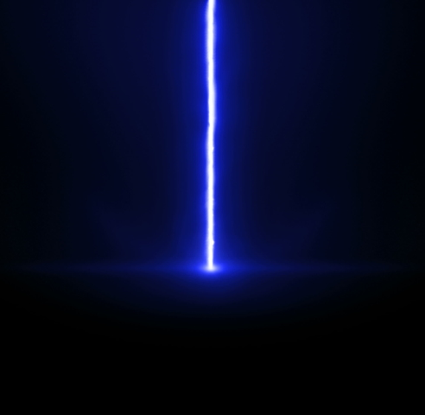
thank you
very much for attention

